Slide 1


PROFESSIONAL READLINES FOR INNOVATION,EMPLOYABILITY AND ENTRENRENEURSHIP
REHABILITATION CONNECT EMPOWERING UNDERTRIAL PRISONERS
ROHIT Y (210701519)
AKSHAY (210701022)

Slide 2
INTRODUCTION
In the complex landscape of the Indian prison system, one segment of the incarcerated population faces unique and enduring challenges: undertrial prisoners. These individuals, awaiting trial, often find themselves caught in a prolonged state of detention, with limited access to legal aid, social support, and psychological services. Recognizing the urgent need to address the plight of undertrial prisoners, a comprehensive mobile application is proposed as a proactive solution to alleviate their struggles and improve their overall well-being. The primary objective of this mobile application is to provide a multifaceted support system for undertrial prisoners, encompassing legal, social, and psychological dimensions. At its core, the mobile application offers a range of features tailored to meet the diverse needs of undertrial prisoners. One of its key functions is to facilitate access to legal aid, connecting individuals with legal experts, clinics, and rehabilitation services. Through intuitive interfaces and secure communication channels, undertrial prisoners can obtain information on their legal rights, navigate complex legal procedures, and manage documentation related to their cases. Educational materials, vocational training programs, and mental health support resources are made readily available to undertrial prisoners, empowering them with the skills and resources necessary for their reintegration into society upon release.

Slide 3
LITERATURE SURVEY
A comprehensive literature survey on the proposed topic of addressing the challenges faced by undertrial prisoners in the Indian prison system through a multifaceted mobile application requires an exploration of various scholarly works, research papers, reports, and relevant literature. This survey aims to provide a thorough understanding of the existing knowledge, insights, and perspectives on the subject matter. Below is a literature survey with an extensive review of relevant literature The Indian prison system has long been plagued by issues related to the treatment and welfare of undertrial prisoners awaiting trial while enduring prolonged detention. Scholars have extensively documented the challenges faced by this vulnerable population, including issues related to overcrowding, inadequate access to legal aid, healthcare services, and rehabilitation programs. According to a report by the National Crime Records Bureau (NCRB), a significant percentage of the prison population in India comprises undertrial prisoners, highlighting the urgency of addressing their needs (NCRB, 2019).

Slide 4
PROPOSED SYSTEM
The proposed system encompasses the development and implementation of a mobile application tailored to address the specific needs and challenges faced by undertrial prisoners within the Indian prison system. Through user-friendly interfaces, secure communication channels, and collaborations with legal aid organizations, healthcare providers, and vocational training institutes, the proposed system aims to empower undertrial prisoners, mitigate the hardships of their incarceration, and facilitate their successful reintegration into society upon release. Key features of the proposed system include real-time access to legal information and assistance, peer support groups, mental health resources, educational materials, vocational training courses, job placement services, and tools for monitoring and tracking rehabilitation progress. By leveraging technology and stakeholder partnerships, the proposed system seeks to address systemic issues within the Indian prison system and uphold human rights principles, ultimately contributing to a more equitable and humane criminal justice system.

Slide 5
METHODOLOGY
The project methodology encompasses a systematic approach to the design, development, and implementation of the mobile application for undertrial prisoners. Initially, a comprehensive needs assessment will be conducted to identify the specific requirements and challenges faced by undertrial prisoners within the Indian prison system. This will involve stakeholder consultations, including undertrial prisoners, legal experts, healthcare providers, and prison authorities, to gather insights and feedback where the user interface, features, and functionalities of the mobile application will be conceptualized. This will involve iterative prototyping and user testing to ensure the application is intuitive, user-friendly, and tailored to the needs of undertrial prisoners.

Slide 6
HARDWARE REQUIREMENTS
The hardware requirements may serve as the basis for a contract for the system’s implementation. It should therefore be a complete and consistent specification of the entire system. It is generally used by software engineers as the starting point for the system design.
Table 3.1 Hardware Requirements
COMPONENTS SPECIFICATION
PROCESSOR Intel Core i5
RAM 8 GB RAM
GPU NVIDIA GeForce GTX 1650
MONITOR 15” COLOR
HARD DISK 512 GB
PROCESSOR SPEED MINIMUM 1.1 GHz
SOFTWARE REQUIREMENTS
The software requirements document is the specifications of the system. It should include both a definition and a specification of requirements. It is a set of what the system should rather be doing than focus on how it should be done. The software requirements provide a basis for creating the software requirements specification. It is useful in estimating the cost, planning team activities, performing tasks, tracking the team, and tracking the team’s progress throughout the development activity.
Python IDLE, and chrome would all be required.

Slide 7
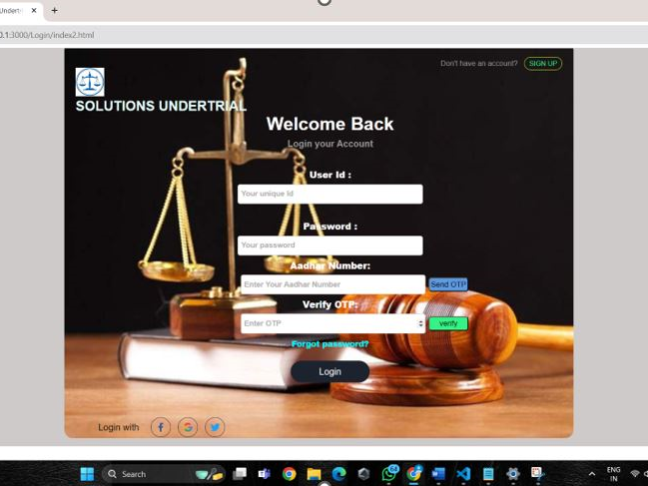
OUTPUTS

Slide 8
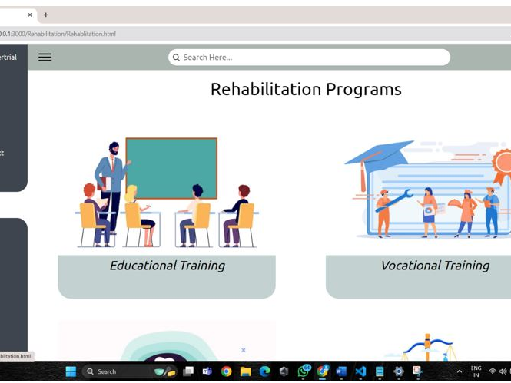
OUTPUTS

Slide 9
CONCLUSION
In conclusion, the proposed mobile application offers a promising solution to address the multifaceted challenges faced by undertrial prisoners in the Indian prison system. By leveraging technology to provide legal aid, access to rehabilitation services, and support for social and psychological well-being, the application has the potential to significantly improve the lives of undertrial prisoners and contribute to their successful reintegration into society. However, the successful implementation of such an initiative requires concerted efforts from various stakeholders, including government agencies, legal aid organizations, healthcare providers, and technology experts. By working collaboratively and prioritizing the needs of undertrial prisoners, policymakers and practitioners can create a more inclusive and humane criminal justice system that upholds the principles of justice, fairness, and human rights. Furthermore, the continuous monitoring and evaluation of the mobile application's effectiveness are crucial to ensure its impact and sustainability over time. Rigorous assessment mechanisms, user feedback mechanisms, and iterative improvements based on data-driven insights are essential components of the app's long-term success.

Slide 10
REFERENCES
United Nations Office on Drugs and Crime. (2015). Handbook on strategies to reduce overcrowding in prisons. Retrieved from https://www.unodc.org/documents/justice-and-prison-reform/HB_to_reduce_overcrowding_in_prisons.pdf
2. Human Rights Watch. (2019). "No Telling Who Will Live or Die": State Control Over Health Care in Indian Prisons. Retrieved from https://www.hrw.org/report/2019/01/23/no-telling-who-will-live-or-die/state-control-over-health-care-indian-prisons
3. National Crime Records Bureau. (2019). Prison Statistics India - 2019. Retrieved from https://ncrb.gov.in/en/prison-statistics-india-2019
4. Ministry of Home Affairs, Government of India. (2020). Model Prison Manual for the Superintendence & Management of Prisons in India. Retrieved from https://www.mha.gov.in/sites/default/files/Model_Prison_Manual_03062020.pdf

Slide 11
Thank You

